Slide 1
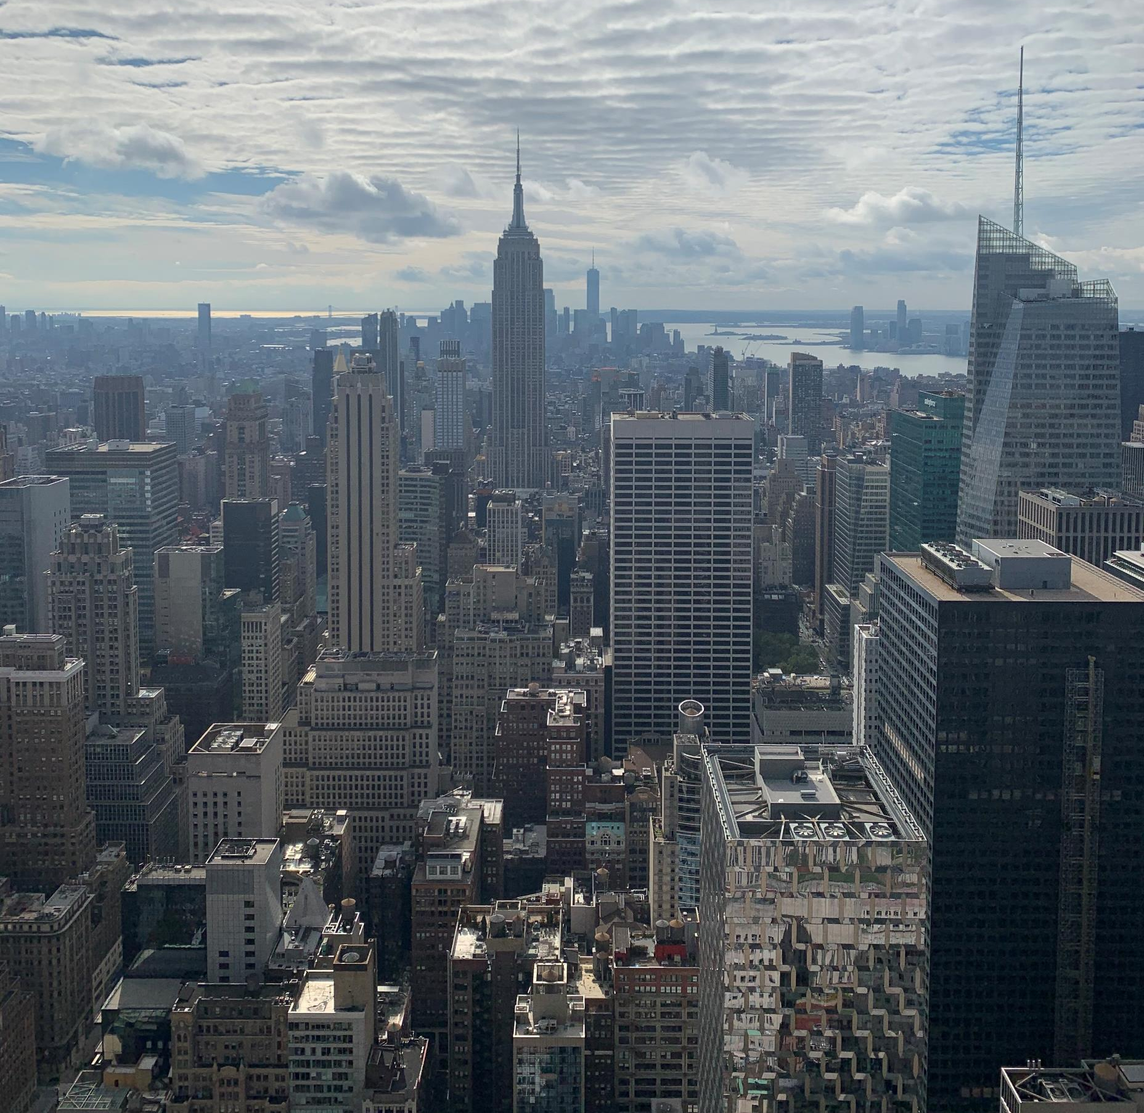
Exploratory Data Analysis of the MTA Turnstile Project
Presented by
Rawan Al-ahmadi

Slide 2
Business story
Help a non-profit organization called ‘The kids are the future’ hand out an event flyer to the summer charity event that they are throwing for children with cancer. They want to achieve these goals:
Get enough exposure to advertise for the event and the organization work.
Target the high-to-medium-income commuters of the subway in New York city.

Slide 3
The approach
Collecting the data into a DB
Cleaning the data
Doing the Exploratory Data Analysis
Giving recommendations to the business

Slide 4
Cleaning the data
Entries and exits numbers are cumulative.
Counters work in reveres or reset
Finding the traffic in the stations

Slide 5
Cleaning the data con.
Adding new columns such as date and time as timestamp
Checking duplicates
Checking null values

Slide 6
tools
Jupyter
Git
Matplotlib
Seaborn
SQLite
SQL3

Slide 7
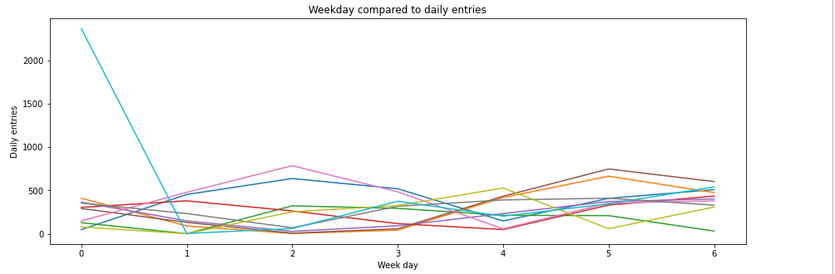
Plotting a single stations by entries daily in a 10-week period

Slide 8
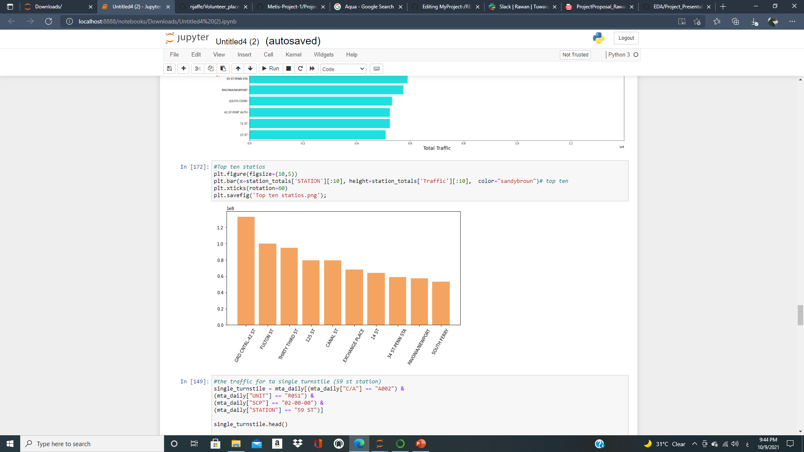
Top 10 busiest stations in the city

Slide 9
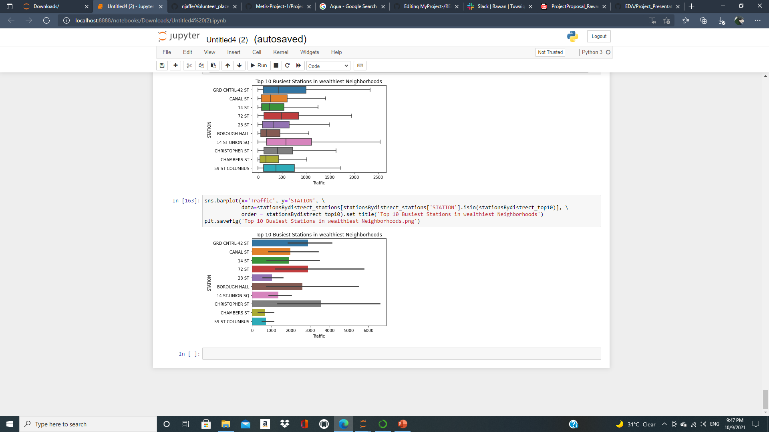
Top 10 busiest stations
in wealthiest neighborhoods

Slide 10
recommendations
Placement of volunteers near the top ten stations during the morning-afternoon period, in these stations:
GRD CNTRL-42 ST : high income regions around the stations.
In midtown Manhattan and service three lines
14 ST-UNION SQ: High income and high traffic because of shops, restaurants, cafes and there is a park near the station.
59th Street–Columbus Circle which service three different lines and have a great deal of traffic is a New York City Subway station complex shared by the IRT Broadway–Seventh Avenue Line and the IND Eighth Avenue Line. It is the eighth-busiest station complex in the system.
Chambers St which is located at the Lower Manhattan is full of hotels and the 9/11 memorial site.
Its also near the world trade center which have a lot of shops, restaurants, and cafes
Notes:
borough hall station Brooklyn region
72nd Street is an express station on the IRT Broadway–Seventh Avenue Line of the New York City Subway, located at the intersection of Broadway, 72nd Street and Amsterdam Avenue (including Verdi Square and Sherman Square) on the Upper West Side of Manhattan. It is served by the 1, 2, and 3 trains at all times.

Slide 11
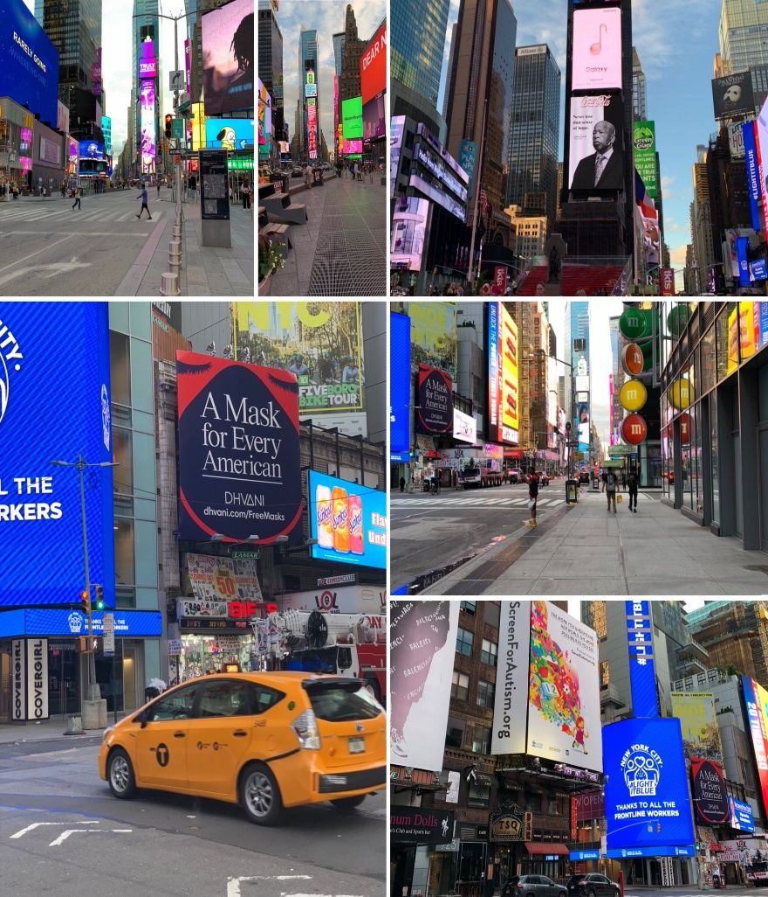
Thanks for listening☺

